Slide 1

: Field of view (FOV)
: mmWave/Thz Beam
: LoS signal blockage
small BS
Obstacle
Obstacle

Slide 2
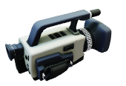

Slide 3

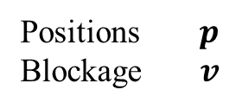

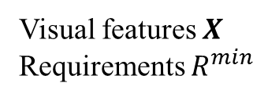
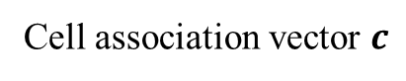
1) Input data acquisition
(Image acquisition & feature extraction)
3) UE detection
(object detection stage)
2) Input data transmission
Voxelizer
Visual features $X$
Requirements $R^{min}$
Positions $p$
Blockage $v$
5) Control signaling
Cell association vector generation
CU in macro BS
Cell association vector $c$
UDN environment
4) Cell association decision
(CA stage)

Slide 4
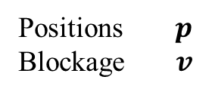
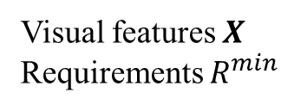
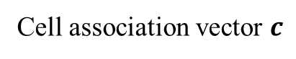
1) Input data acquisition
(Image acquisition & feature extraction)
3) UE detection
(object detection stage)
2) Input data transmission
Voxelizer
Visual features $X$
Requirements $R^{min}$
Positions $p$
Blockage $v$
5) Control signaling
Cell association vector generation
CU in macro BS
Cell association vector $c$
UDN environment
4) Cell association decision
(CA stage)

Slide 5
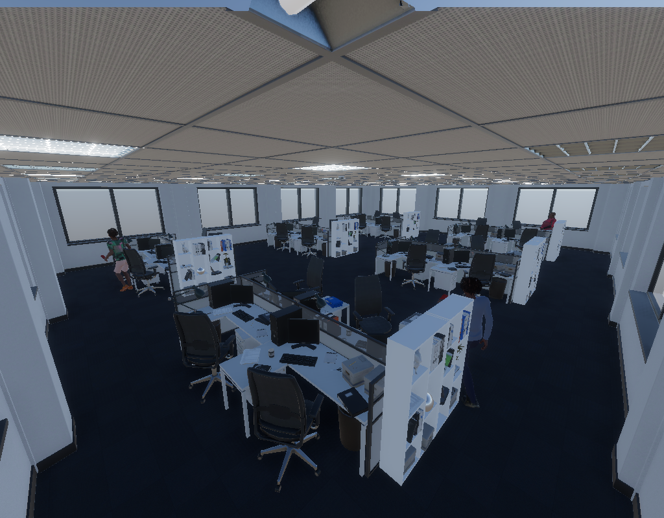
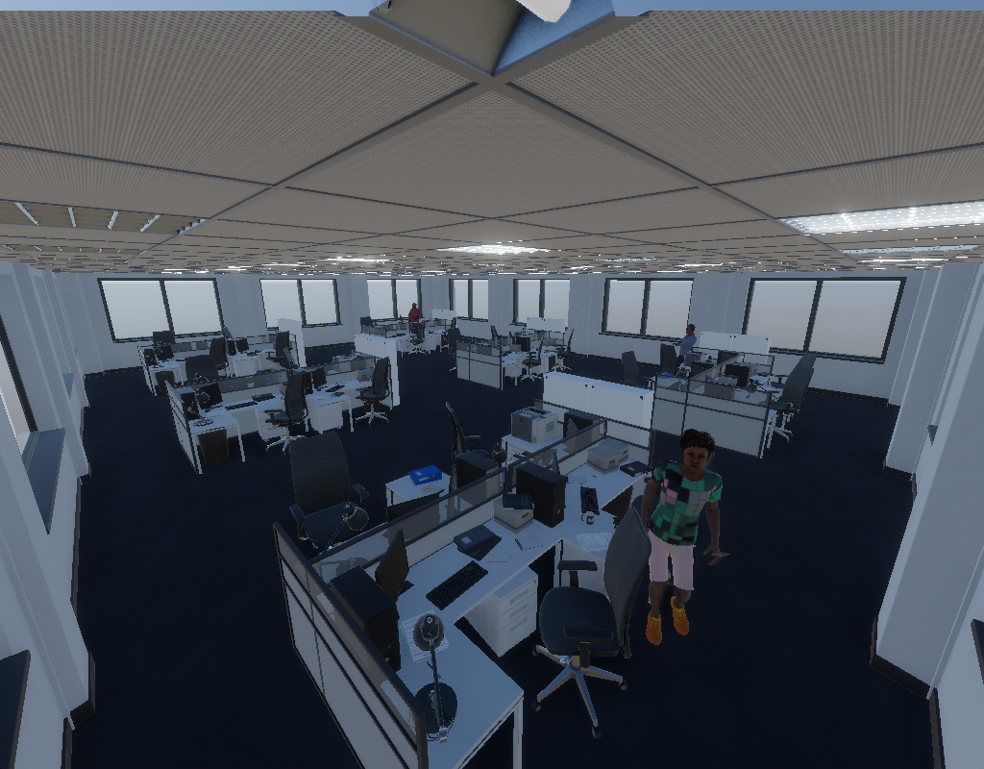
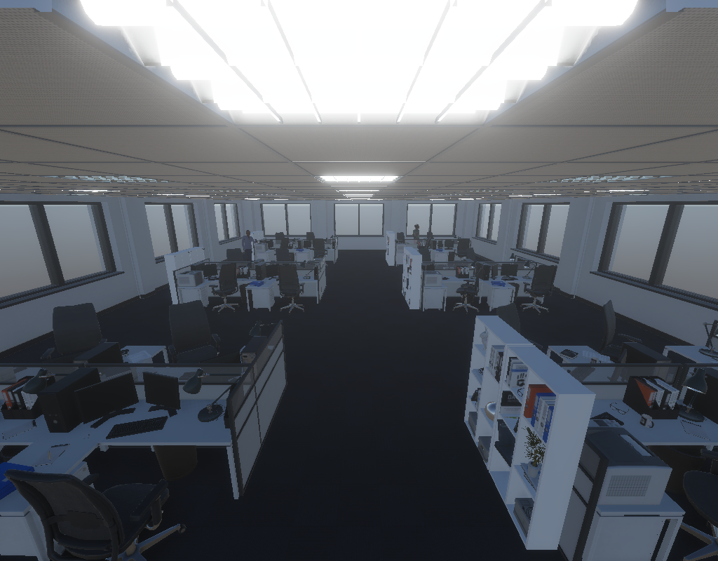
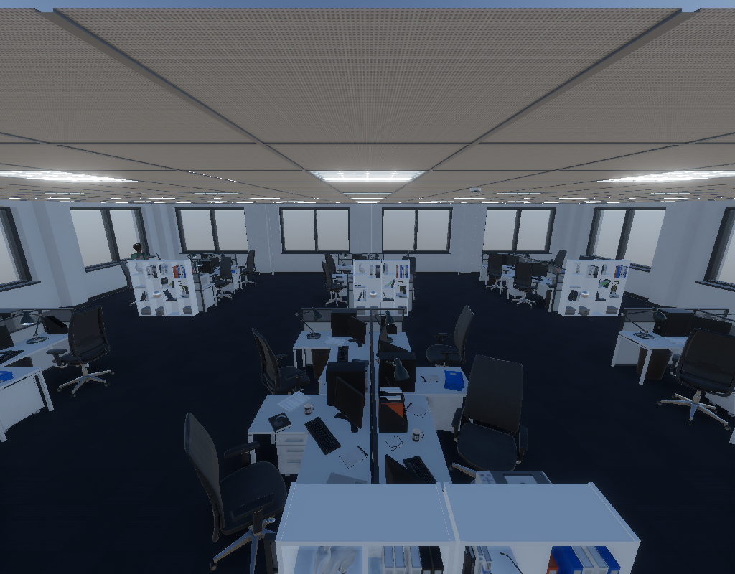
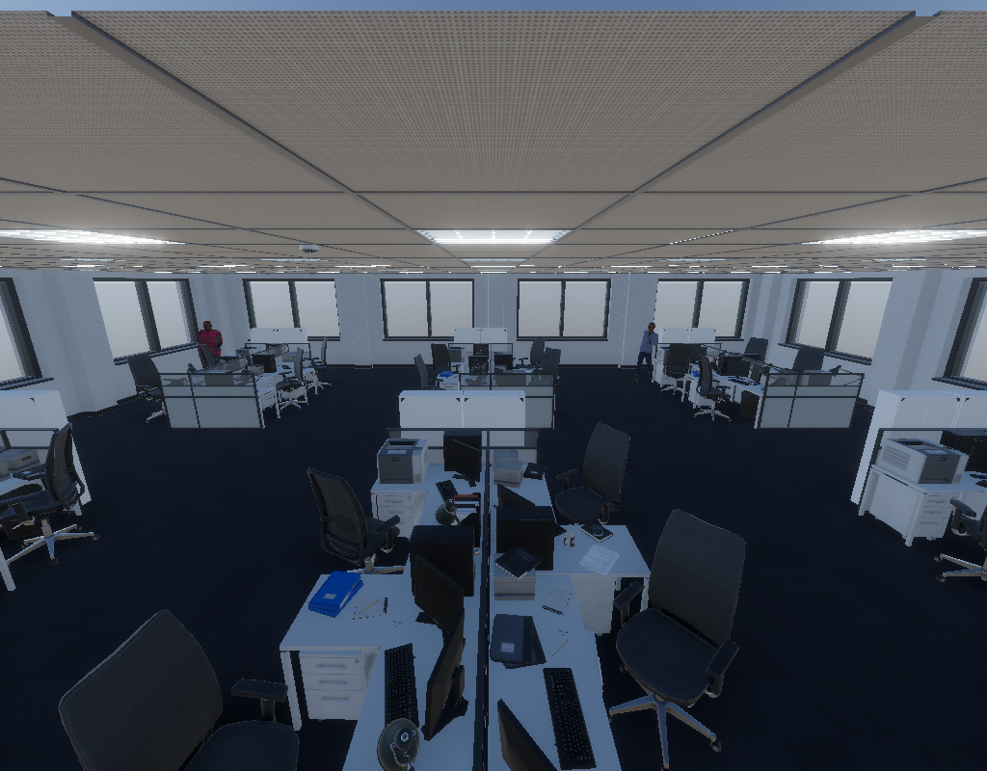
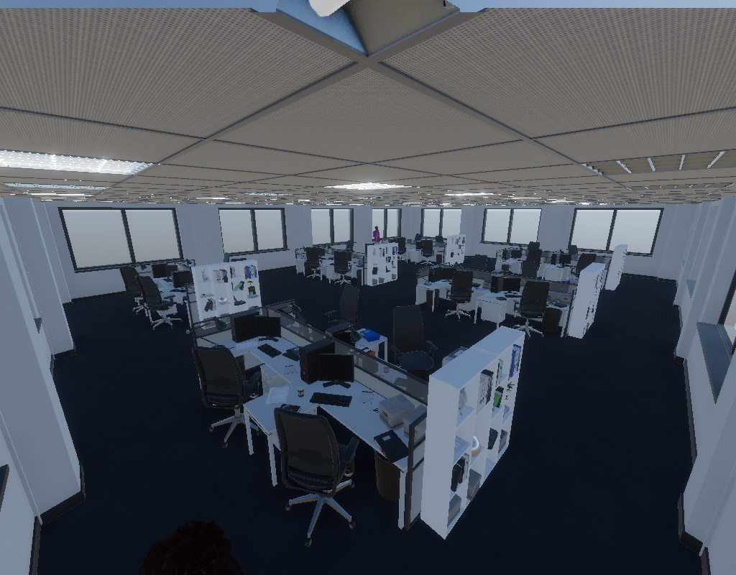
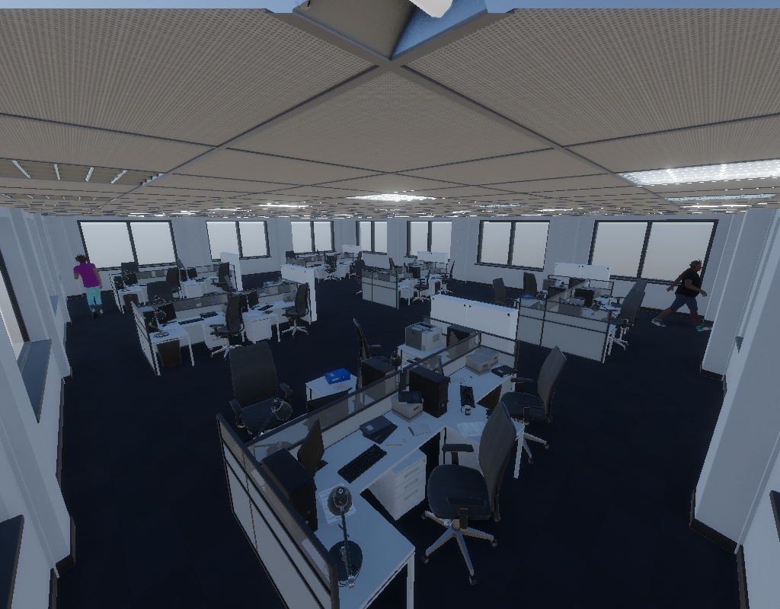
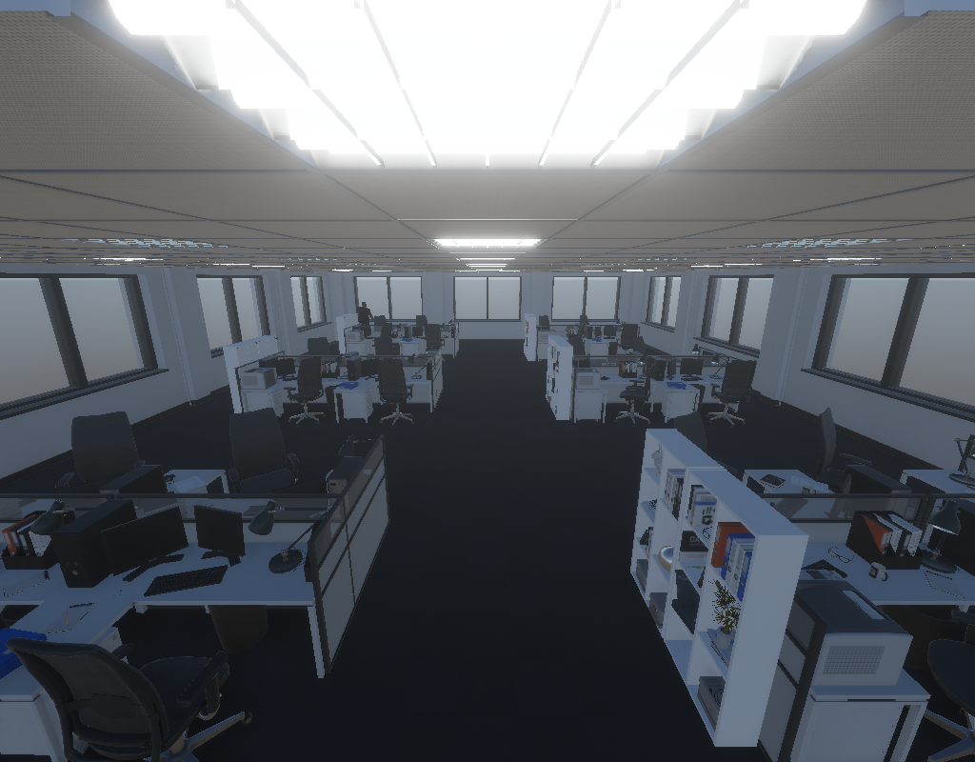
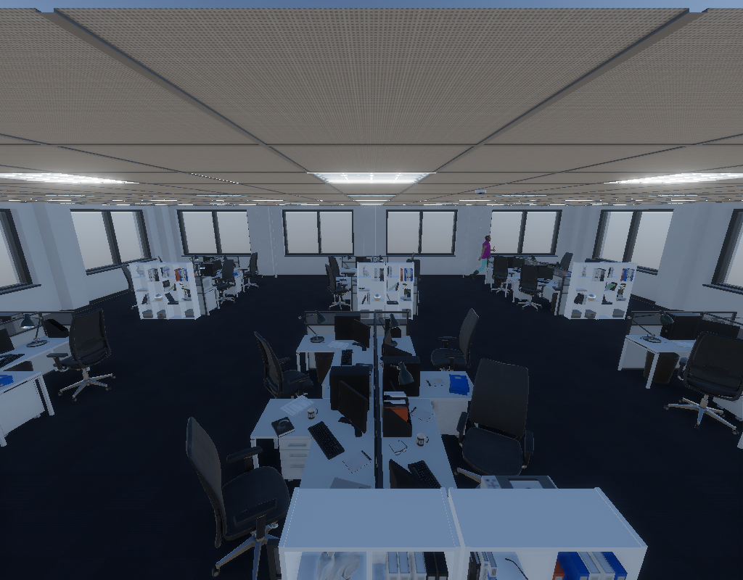
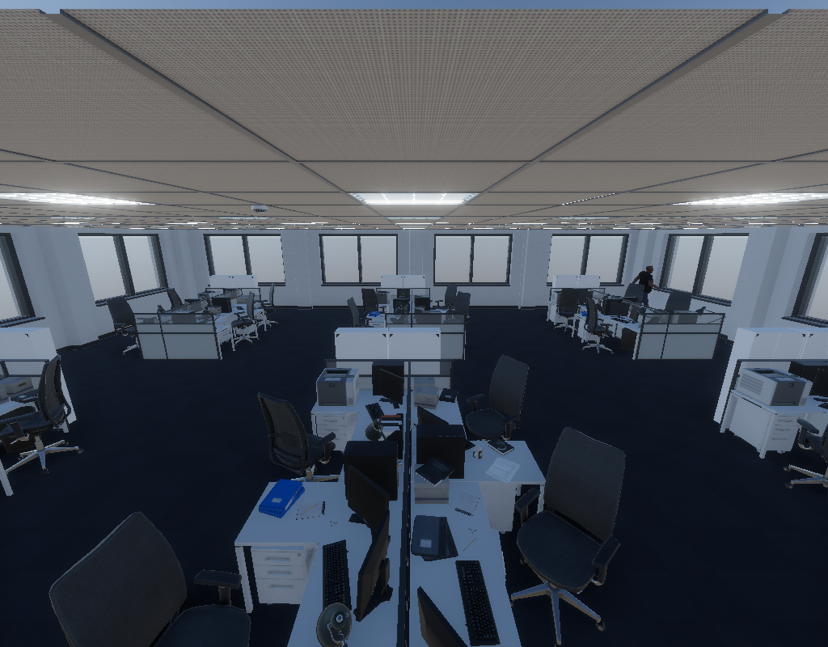

Slide 6


Slide 7
Top-view of
visual features
UE position &
Blockage indication
3D Detection Head
Feedforward
Feature
…
Feature
Feature
Voxelization
Decoder
Backbone
Neck
Feature
…
Feature
Feature
Voxelization
Decoder
Multi-head Cross Attention
Feature
…
Feature
Feature
Voxelization
Decoder
Normalization
Feature
…
Feature
Feature
Voxelization
Decoder
Image
Processor
Fully-connect network
Multi-head self attention
Object Queries
Normalization
Image
Image
Image
…
Queries
Multi-scale
visual features
Image

Slide 8
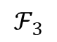
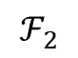
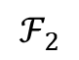
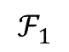
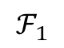
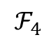
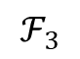
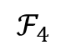
Multi-scale
visual features
Category Queries
Backbone
Neck
Convolutional layer
Neck
Feedforward
Transformer Block
Decoder
Convolutional layer
$$ℱ_{4}$$
$$ℱ_{4}$$
Decoder
Multi-head Cross Attention
Transformer Block
$$ℱ_{3}$$
$$ℱ_{3}$$
Convolutional layer
Decoder
Transformer Block
$$ℱ_{2}$$
$$ℱ_{2}$$
Normalization
Convolutional layer
$$ℱ_{1}$$
$$ℱ_{1}$$
Decoder
Transformer Block
Image
Processor
Multi-head self attention
Linear Embedding
3D Detection Head
Patch partition
Normalization
RGB
Image
RGB
Image
UE position &
Blockage indication
…
RGB Image
Queries

Slide 9
Category Queries
Neck
Decoder
Decoder
Decoder
Decoder
Image
Processor
3D Detection Head
RGB
Image
RGB
Image
UE position &
Blockage indication
…

Slide 11
Backbone
Neck
Multi-scale
visual features
Image

Slide 12
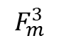
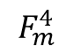
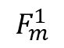
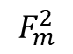
Backbone
Neck
Convolutional layer
$$F_{m}^{1}$$
Transformer Block
Convolutional layer
$$F_{m}^{2}$$
Transformer Block
Convolutional layer
$$F_{m}^{3}$$
Transformer Block
Convolutional layer
$$F_{m}^{4}$$
Transformer Block
Linear Embedding
Patch partition
RGB Image

Slide 13
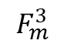
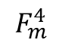
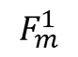
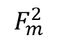
Neck
Backbone
$$F_{m}^{1}$$
Convolutional layer
Transformer Block
$$F_{m}^{2}$$
Convolutional layer
Transformer Block
$$F_{m}^{3}$$
Convolutional layer
Transformer Block
$$F_{m}^{4}$$
Convolutional layer
Transformer Block
Linear Embedding
Patch partition
RGB Image

Slide 14
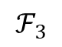
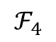
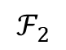
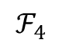
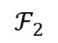
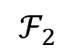
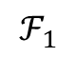
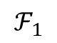
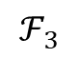
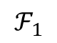
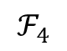
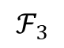
$$ℱ_{4}$$
…
$$ℱ_{4}$$
$$ℱ_{4}$$
$$ℱ_{3}$$
$$ℱ_{3}$$
…
$$ℱ_{3}$$
$$ℱ_{2}$$
$$ℱ_{1}$$
$$ℱ_{2}$$
…
$$ℱ_{2}$$
Feature
…
Feature
Feature
…
$$ℱ_{1}$$
$$ℱ_{1}$$

Slide 15
Feedforward
Multi-head Cross Attention
Normalization
Multi-head self attention
Normalization
Queries

Slide 16
Top-view of
visual features

Slide 18
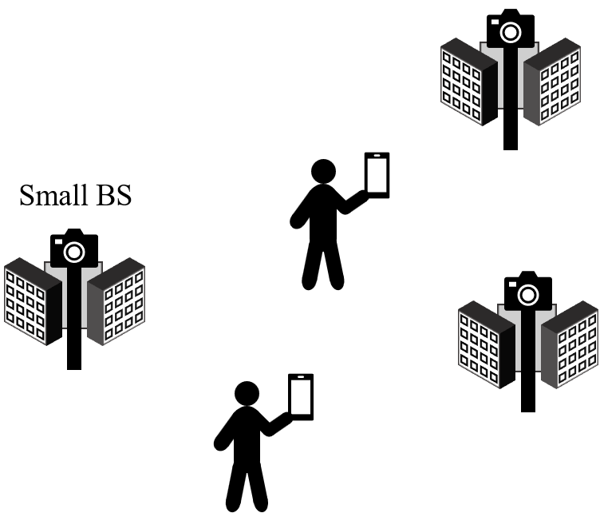


Vision acquisition
Multiview processing
3D object and blockage detection
Cell association
: occluded object
Distance: 2m
Azimuth angle:
Elevation angle:
LOS:
: visible object
Top view
Person: 95%
(1.2 0.8 3)
Control
command
Small BS
Phone: 87%
Phone: 79%
Left view
y
(0.5 1.2 1.7)
z
x
Person: 92%
Right view

Slide 19
Proposed Computer Vision-based Cell Association using Transformer
Multi-view images
Computer vision stage
Cell association stage
Distance: 2m
Azimuth angle:
Elevation angle:
Single-view processing
Coordinate
post-processing
Voxelization
LOS link
post-processing
User positioning
Cell association
Cell association vector generation

Slide 20
User positioning
Voxelization
3D object detection

Slide 21
Small BS

Slide 22
: occluded object
: visible object
Person: 95%
(1.2 0.8 3)
Phone: 87%
Phone: 79%
y
(0.5 1.2 1.7)
z
x
Person: 92%

Slide 23
LOS link
Azimuth angle: 25
Elevation angle: -19

